Slide 1
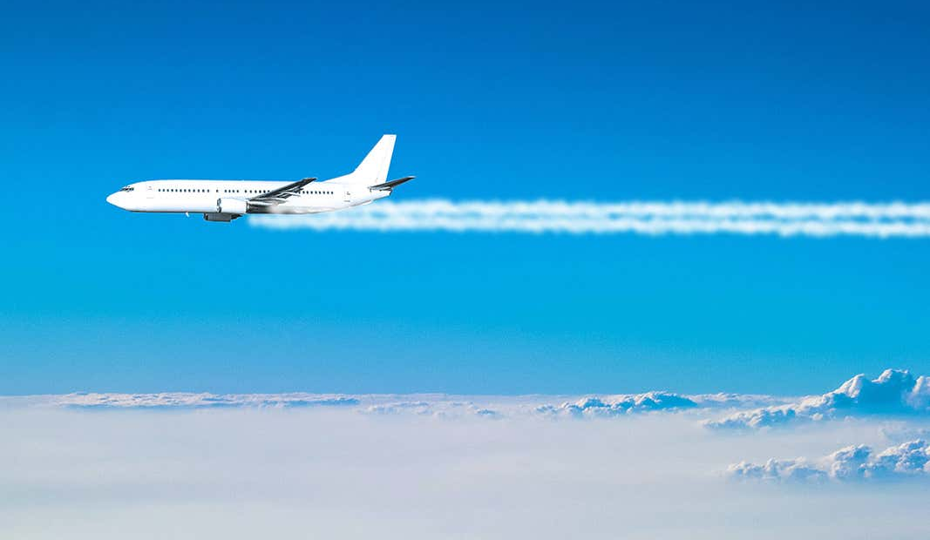
Aviation Accident Risk Analysis
Makena Odongo
10/02/2025

Slide 2
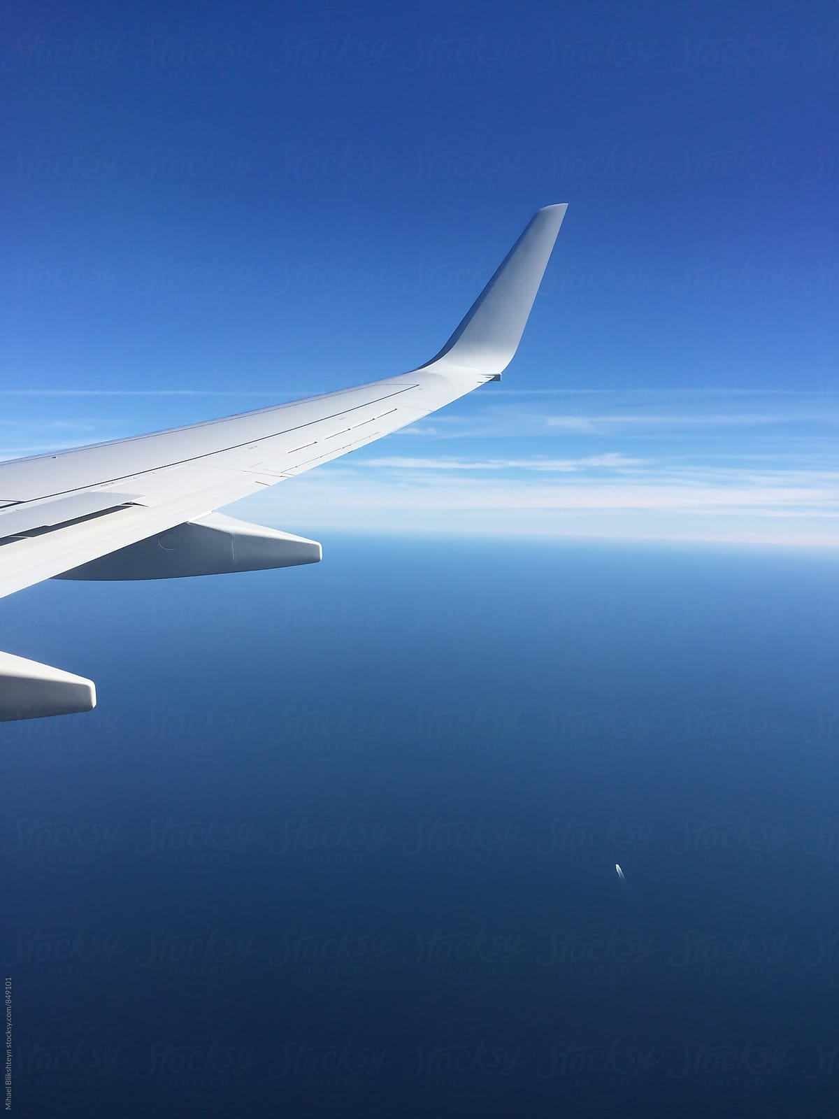


What is the problem?
BlueJet Ltd is expanding into aviation, but need to understand aircraft safety risks before investing.
2

Slide 3


Why does it Matter?
The impact of aviation accidents on safety, costs, regulations, and reputation.
Key Questions:
Which aircrafts are the riskiest?
What factors contribute to accidents?
How can we mitigate these risks before investing?
3

Slide 4

Data & Analysis
The source of the dataset is NTSB.
Data structure: aircraft make, engine type, purpose of flight, weather conditions, casualties, etc.
Analysis was done using Python language and the data visualization was performed using Tableau
4

Slide 5
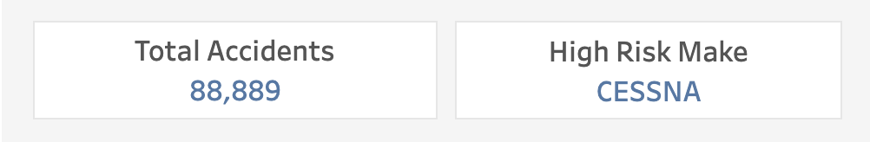
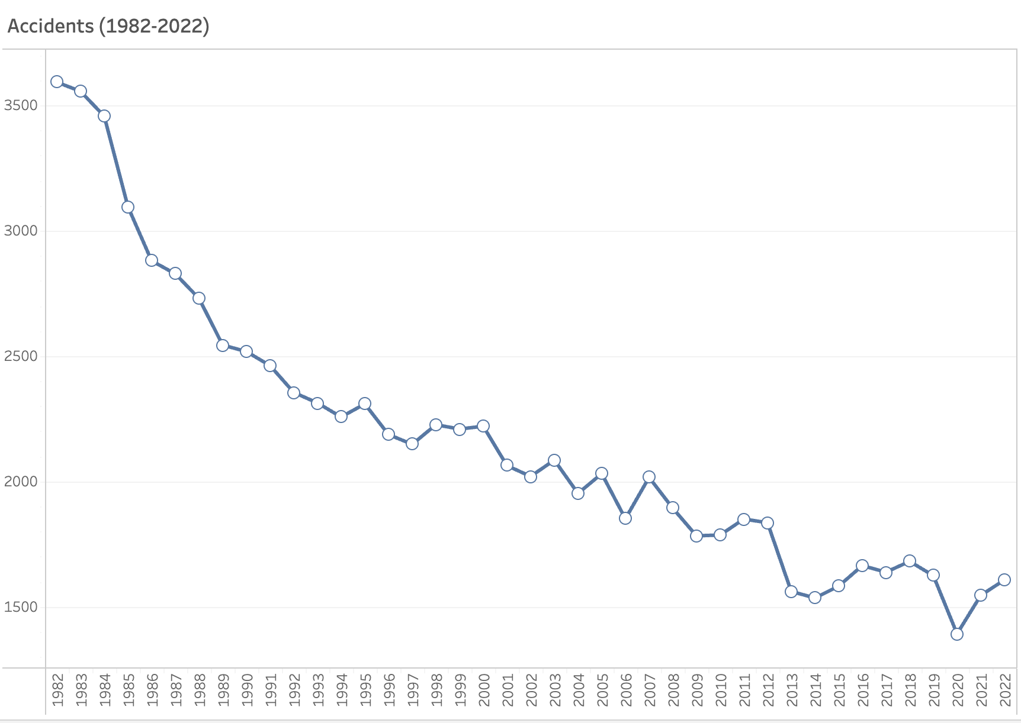
As per the analysis:
Over the years CESSNA have the highest accident rate—this should be a red flag for future investments.
5

Slide 6
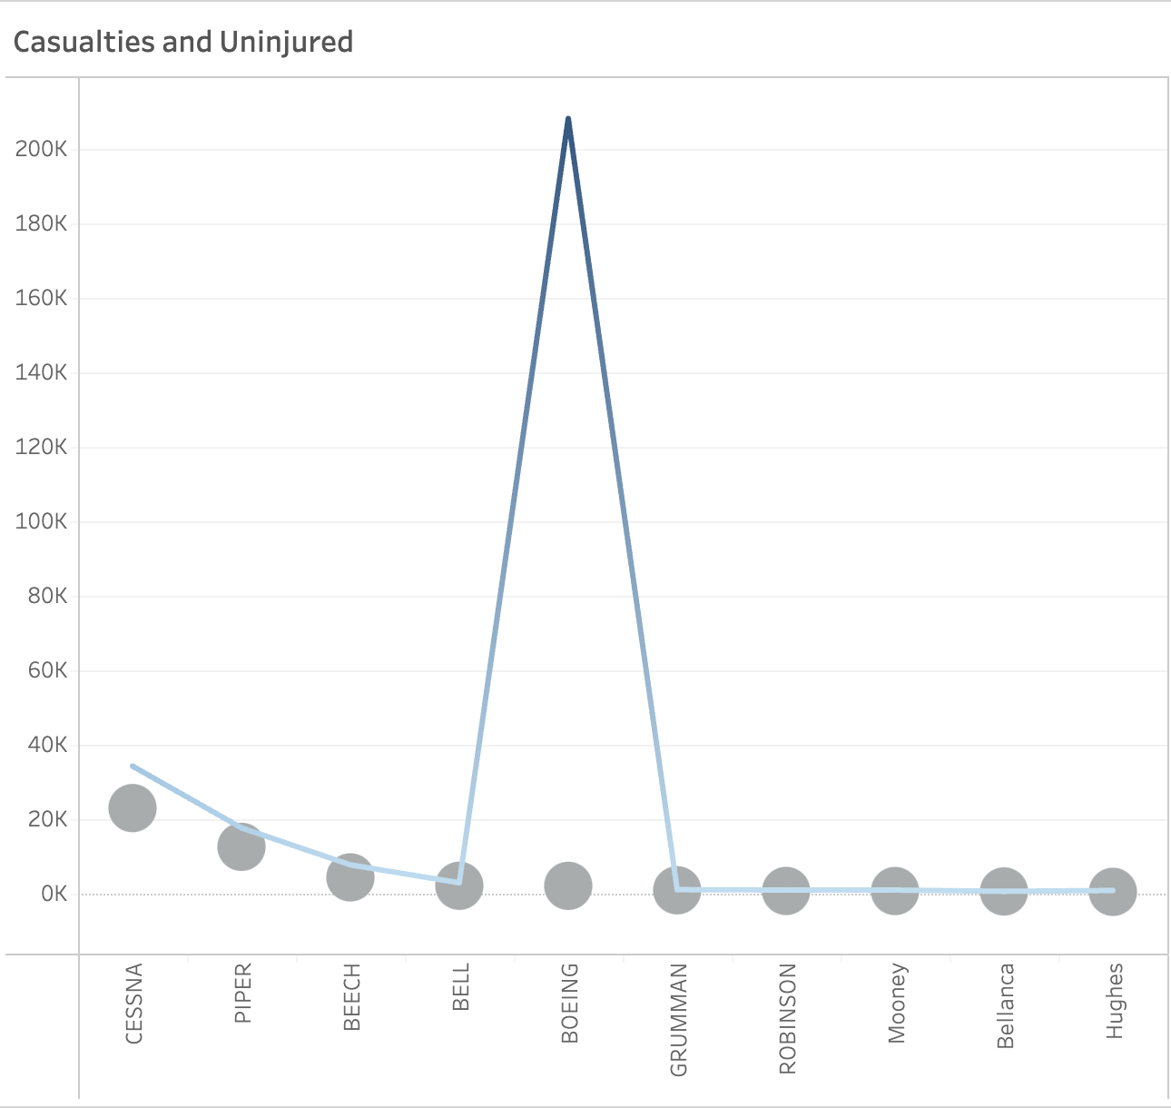

Across the different makes the degree of injury varies:
Some aircraft types have more survivable accidents than others, in this case, the make Boeing stands out. This could inform our insurance and fleet decisions.
6

Slide 7
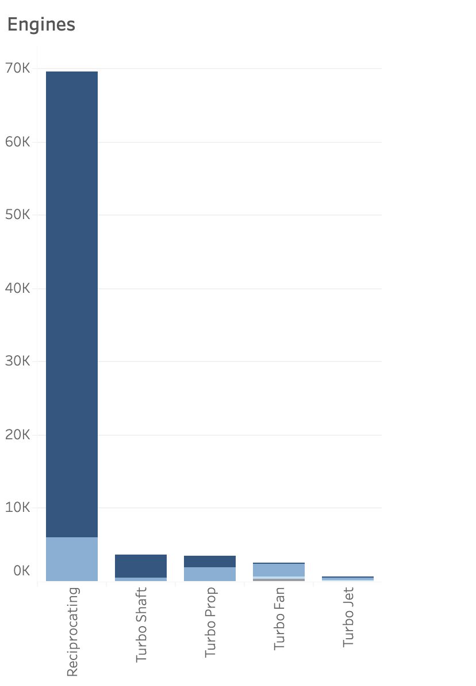
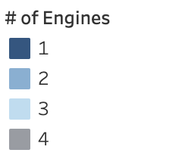
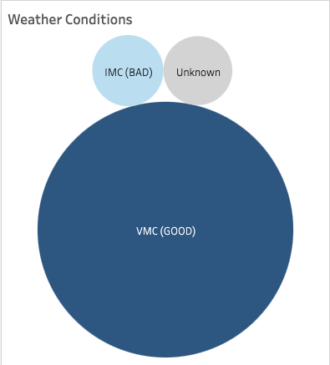
When looking at the # of accidents other contributing factors include:
Fewer engines, notably the reciprocating engine, are more prone to accidents. Weather was not a key factor for over 90% of the factors.
7

Slide 8
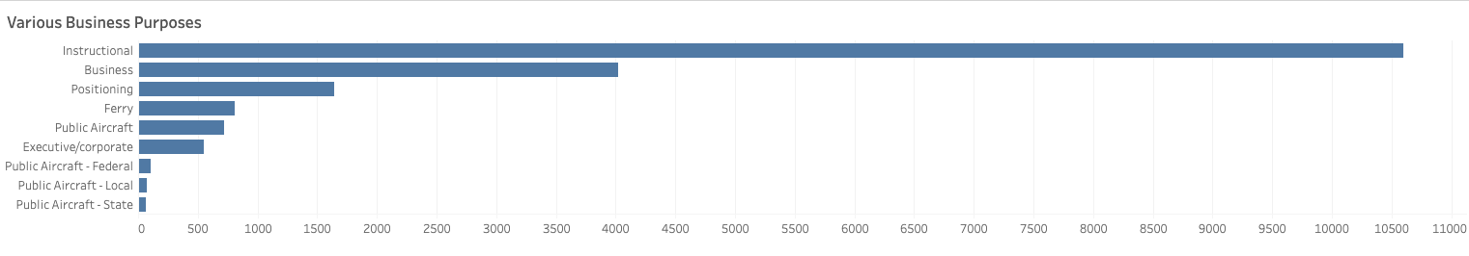
We explored the different business model:
Instructional flying is a significantly riskier business venture than executive/corporate flying.
8

Slide 9

Business Recommendations
Investment Strategy: Avoid investing in aircraft makes and models with high accident rates.
Fleet Selection: Prioritize aircraft with fewer casualties, numerous engines and better safety records.
Prioritize safer business models: Invest in aircraft activities with lower accident risk, instead of high-risk operations.
9

Slide 10

Next Steps
How do we proceed?
Conduct deeper analysis on accident causes.
Investigate insurance costs and regulations.
Develop a risk assessment framework for future investments.
Expand analysis to global accident datasets for broader insights.
10

Slide 11

Thank You
11

